Slide 1
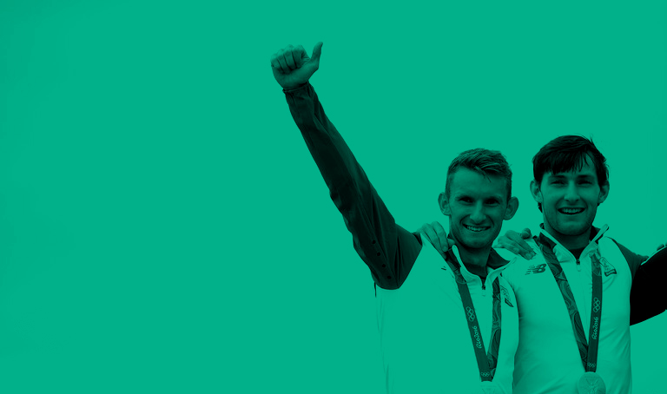
Athletes
Commission
Shane O’Connor (Snow Sports) CHAIRMAN
Gavin Noble (Triathlon) VICE-CHAIRMAN
David Gillick (Athletics)
David Harte (Hockey)
Derval O’Rourke (Athletics)
Judy Reynolds (Equestrian)
James Nolan (Athletics)
Kenneth Egan (Boxing)
Melanie Nocher (Swimming)

Slide 2
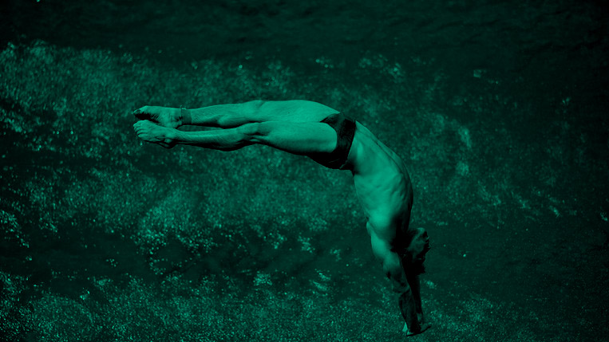
Vision
That Ireland is the best country in the world to be an Olympian or an aspiring Olympic athlete

Slide 3
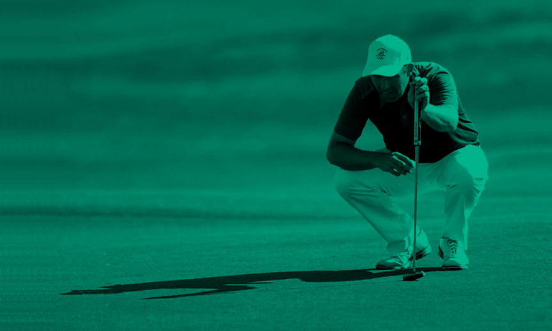
Mission
To Support the welfare of Irish Olympic Athletes and in doing so ensure that their voice is represented during all parts of the Olympic Journey

Slide 4
Stakeholders
Olympians and Qualified Olympic Athletes
National Governing Bodies
Athletes Families

Slide 5
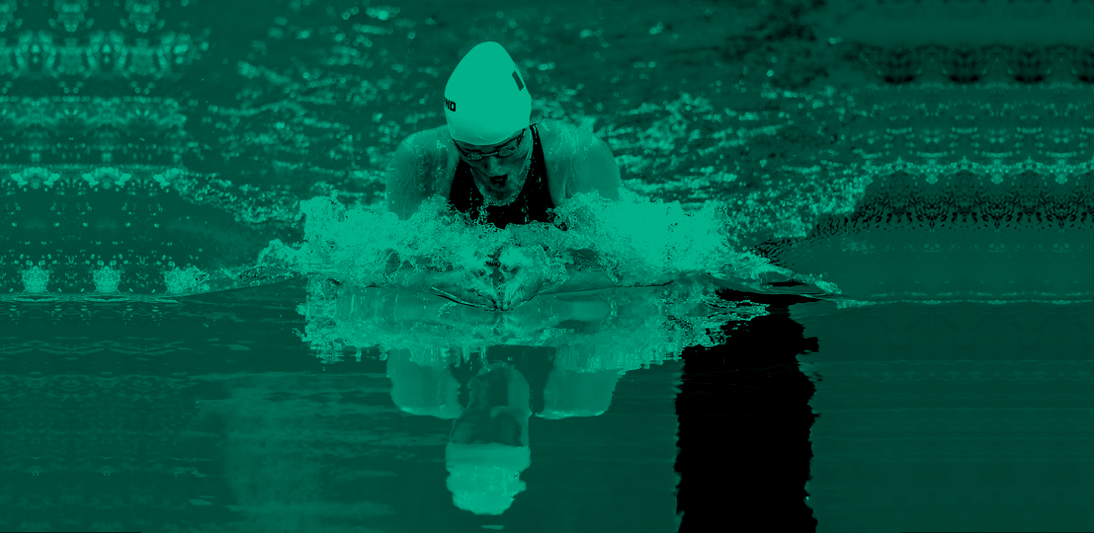
Strategic Pillars
Athlete Welfare
Games Operations
Communications

Slide 6
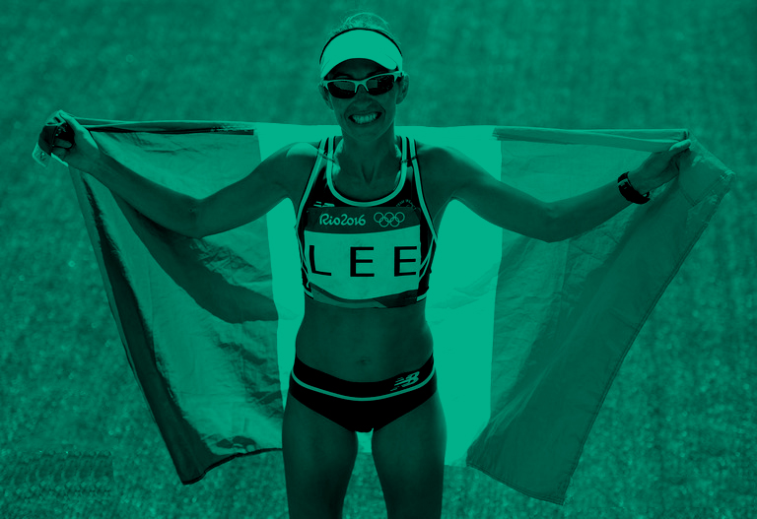
Our Strategy
That Ireland is the best country in the world to be an Olympian or an aspiring Olympic athlete
VISION
To support the welfare of Irish Olympic Athletes and in doing so ensure that their voice is represented in all parts of an Olympic journey
MISSION
STAKEHOLDERS
Olympians and qualified Olympic athletes, OCI, Sport Ireland, Sport Northern Ireland, Irish Institute of Sport, Department of Transport Tourism and Sport, National Federations
STRATEGIC PILLARS
ATHLETE
WELFARE
GAMES
OPERATIONS
AWARENESS & COMMUNICATIONS
INITIATIVES
Advocate for the athlete voice while simultaneously working to empower athletes to help shape athlete welfare and education initiatives.
Develop and maintain relationships with stakeholders and other key organizations to support in the development of athlete welfare and education pathways.
Advocate for athlete input to OCI Olympic Games planning.
Advocate for athlete input to any OCI initiatives that might have an impact on the athlete body.
Ensure visibility and transparency within the Irish Olympic movement for all current and aspiring Irish Olympic athletes.
Engage and empower the wider Irish Olympic athlete family past and present.
Notes:
Our working strategy and initial thoughts

Slide 7
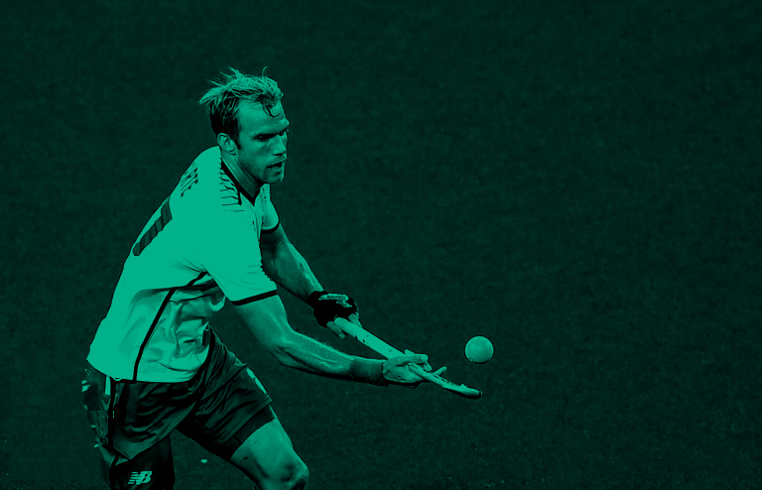
Our Strategy
INITIATIVES
Advocate for the athlete voice while simultaneously working to empower athletes to help shape athlete welfare and education initiatives.
Develop and maintain relationships with stakeholders and other key organizations to support in the development of athlete welfare and education pathways.
PROGRAMS
Develop a system to facilitate regular communication between athletes and the athlete commission;
Actively solicit athlete feedback to ensure we capture the real athlete concerns/issues;
Ensure regular communication from athlete commission to athletes on progress of any ongoing initiatives;
Ensure the athlete voice is represented to all stakeholders and relevant organizations.
Build and maintain relationships with below organizations to help foster training and career development pathways for active and transitioning athletes:
OCI;
NGBs;
Sport Ireland and Sport Institute Ireland;
Sport Northern Ireland;
IOC and EOC athletes commissions.
Build and maintain relationship with Olympic Alumni to foster opportunity for athletes transitioning out from active competition;
Build relationship and engage with Government to represent athlete challenges.
Notes:
Our working strategy and initial thoughts

Slide 8
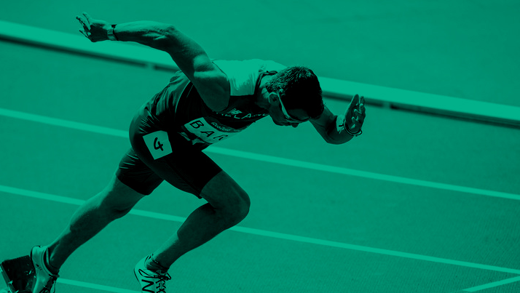
Our Strategy
INITIATIVES
Advocate for athletes in OCI Olympic Games planning.
Advocate for athlete input to any OCI initiatives that might have an impact on the athlete body.
PROGRAMS
Athlete commission representation on OCI sub-committee planning for Olympic Games;
Solicit athlete feedback for input to OCI sub-committee planning for Olympic Games.
Athlete commission representation on OCI working groups that might have a direct impact on the athlete body;
Ensure to maintain an awareness of any IOC support programs which may provide opportunity to Irish Olympic athletes;
Solicit athlete feedback for input to any relevant OCI working groups.
Notes:
Our working strategy and initial thoughts

Slide 9
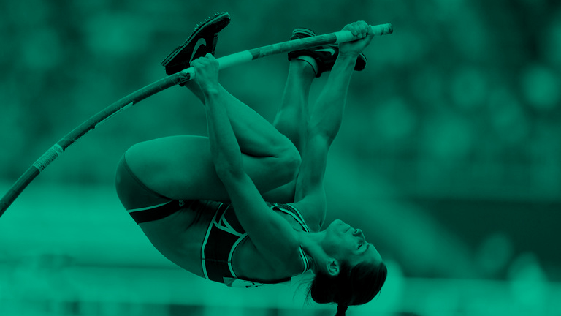
Our Strategy
INITIATIVES
Ensure visibility and transparency within the Irish Olympic movement for all current and aspiring Irish Olympic athletes.
Engage and empower the wider Irish Olympic athlete family past and present.
PROGRAMS
Develop a system to facilitate regular communication between athletes and the athlete commission;
Represent the voice of Olympic athletes within the OCI board;
Communicate with athletes on all initiatives which may provide opportunity, for example IOC solidarity support programs.
Develop an up to date database of all Irish Olympians past and present;
Develop an Olympic Alumni;
Host an athlete Olympic Expo.
Notes:
Our working strategy and initial thoughts

